Slide 1



Week of the Road Traffic Safety
May, 16-22, 2016
Organizer: Ministry of Health of Ukraine
Coordinator: State enterprise “Ukrainian Medical Center
of Road Traffic Safety and Informational Technologies”
of the Ministry of Health of Ukraine

Slide 2
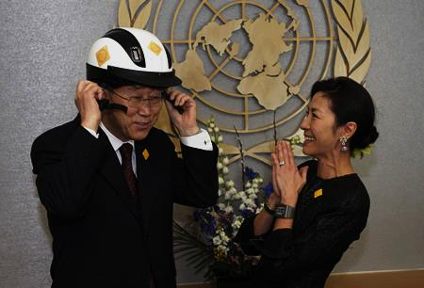

The Week has passed as a part
of the Decade of the Road Traffic Safety (2011-2020)
Aim of the Decade: decrease of mortality and traumatism due to traffic accidents
Direction of activities
Road traffic safety management
Projecting and building of safe roads
Safe transport vehicles
Safe behavior of road users
Help to persons having become road traffic accident victims
“The Decade of actions aiming to secure the road traffic safety may help all the countries to enter the way leading to more safe future”...
(From the Message of the General Secretary of the UNO Pan Gi Mun on the occasion of the Decade beginning).

Slide 3
Week of the Road Traffic Safety
Weeks of the road traffic safety are now being organized all over the world within the Decade of Road Traffic Safety Securing (2011-2020), their aim being the attraction of the society’s attention to problems of road traffic accidents and mortality as well as, first of all, to the search of possibilities for solving this problem. More than 1.3 million persons perish each year because of traffic accidents, about 50 million becoming traumatized.
The level of traffic accident traumas and their consequences in Ukraine is the worst among European states as well as the level of irreparable loss of humans and economical damage.
Every year more than 4,000 persons perish on Ukrainian roads, more than 30,000 humans becoming traumatized. Traffic accidents in Ukraine are the leading cause of mortality among young people aged from 15 to 24 and the second death cause among younger persons – children aged from 5 to 14.
The aim of the Week of the Road Traffic Safety is the unification of efforts of state authorities, business, social institutions, scientific community, mass media, and of whole society aiming to accomplish state and international programs concerning the traffic safety and to assure the support of rules of the road traffic by all the traffic participants.
In 2015, the United Nations Organization determined the children safety on roads as the leading theme of the Week, so Ukraine supported this proposition and carried out the All-Ukrainian Week of the Traffic Safety having taken into consideration this theme*.
The Ministry of Health of Ukraine supported by the Ministry of Home Affairs, Ministry of Infrastructure, Ministry of Education and Science as well as by other ministries and departments, by scientific communities, Global Bank, World Health Organization, international and home associations carried out a series of actions aiming to increase the level of the population’s knowledge concerning the traffic safety, especially the children safety, prevention of road traumatism, perfection of traffic health care etc.
In 2015, the highest national authorities decided to carry out some traffic safety actions during the week of road traffic safety each year.

Slide 4
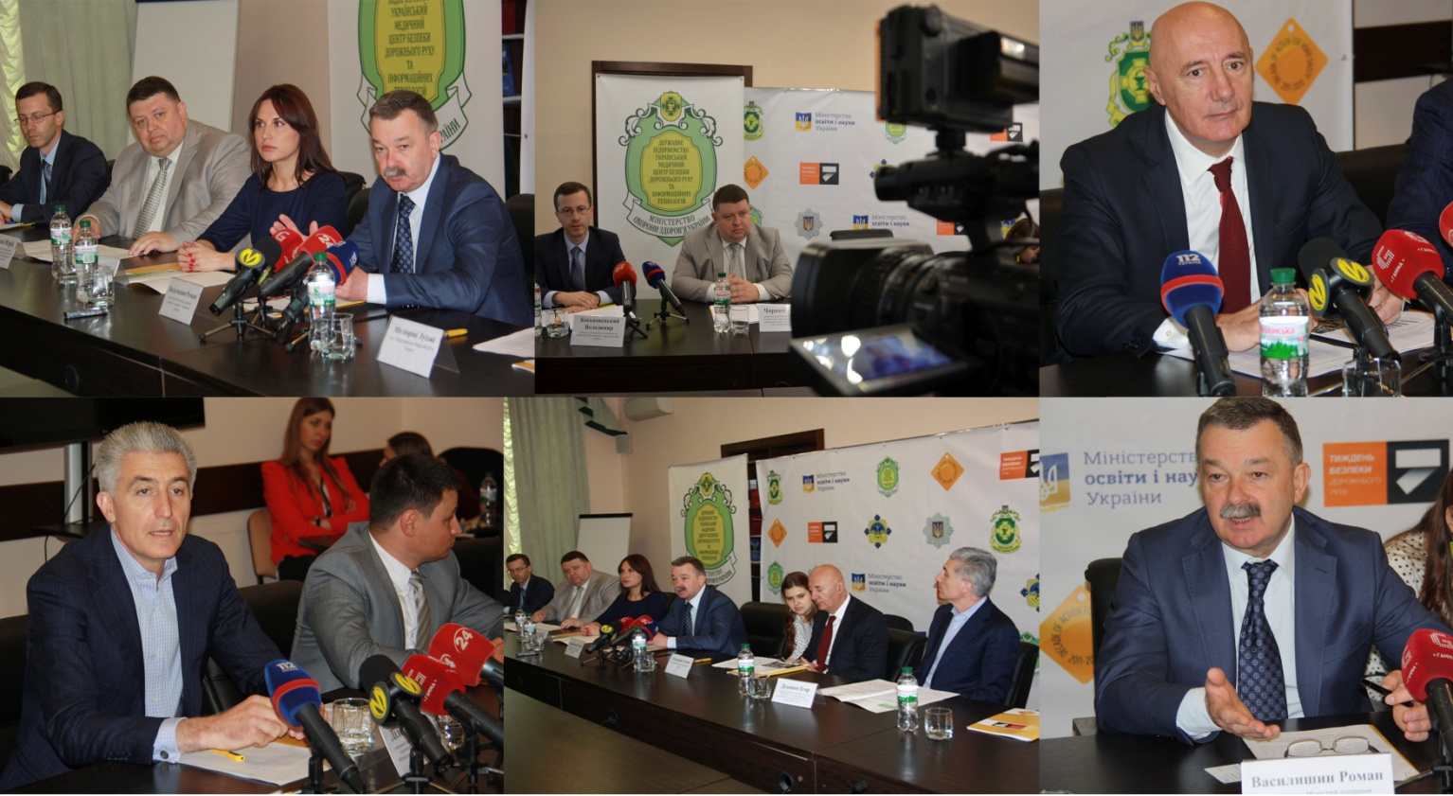
May 16, 2016
Press-conference on the occasion
of the Week of the Road Traffic Safety beginning
The press-conference on the occasion of the week of the Road Traffic Safety (May, 16-22 2016) initiated by the Ministry of Health of Ukraine took place on the 16th of May 2016.
The participants of the conference were representatives of different ministries and departments: Roman Yosypovych Vasylyshyn – vice-minister of the Ministry of Health of Ukraine, Yuri Olegovych Chorny – director of the state enterprise “Ukrainian Medical Center of Road Traffic Safety and Informational Technologies” of the Ministry of Health of Ukraine, Luigi Migliorini – vice-representative of the UNO Bureau in Ukraine, Igor Anatoliyovych Didenko – deputy of the Verkhovna Rada, Рresident of the Subcommittee of the Road Traffic Safety, Iryna Volodymyrivna Sysoyenko – deputy of the Verkhovna Rada, vice-president of the Verkhovna Rada Committee on the Road Traffic Safety, Volodymyr Mykhailovych Kos’kovets’ki – director of the Department of Safety on the Transport of the Infrastructure Ministry of Ukraine, Olexi Biloshytski – vice-chief of the Department of the Patrol Police of the National Police of Ukraine.

Slide 5
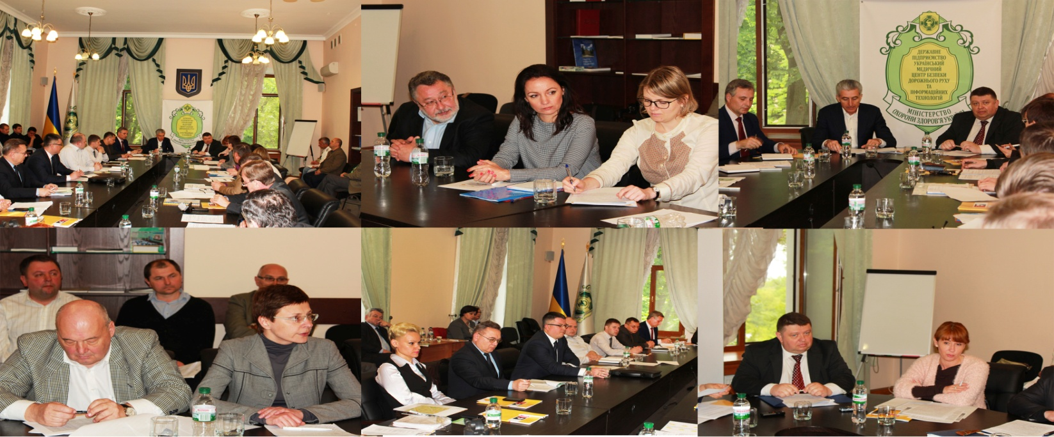
May, 17, 2016
Round-table “Guaranteeing of the necessary health care
in the field of road traffic safety. Actual legislative problems
and approaches for their solving”
On the occasion of the Week of the Road Traffic Safety, the round-table “Guaranteeing of the necessary health care in the field of road traffic safety. Actual legislative problems and approaches for their solving” took place at the Ministry of Health of Ukraine under the guidance of the President of the Subcommittee of the Road Traffic Safety of the Verkhovna Rada of Ukraine Igor Didenko and the director of the state enterprise “Ukrainian Medical Center of Road Traffic Safety and Informational Technologies” of the Ministry of Health of Ukraine Yuri Chorny. A lot of professionals in the field of communications and organizers of road traffic safety (pani Barbara Krol et al.) were participants of this road-table.
All the road-table participants discussed the problems concerning the aim for the realization of projects and acceptation of legislative documents leading our country to decreased traumatism and victims due to road accidents.

Slide 6
Project
RESOLUTION
of the round-table “Guaranteeing of the necessary health care in the field of road traffic safety. Actual legislative problems and approaches for their solving”
The round-table was carried out according to the General Plan of Actions Concerning the Week of Road Traffic Safety (May, 16-22, 2016) designed and confirmed on the 30th of March according to the commission
of the Cabinet of Ministers of Ukraine (01.03.2016, N 2671/1/1-16
on the occasion of the Decade of the Road Traffic Safety (2011-2010)
The round-table took place on the 17th of May 2016
The participants of the round-table “Guaranteeing of the necessary health care in the field of road traffic safety. Actual legislative problems and approaches for their solving” having took place on the 17th of May 2016 on the occasion of the Week of the Road Traffic Safety having been planned and confirmed according to the commission of the Cabinet of Ministry of Ukraine (30.03.2016, N 2671/1/1-16) underline that the guaranteeing of the necessary health care in the field of the road traffic safety belongs to the most important priorities of the state policy according to the national interests of Ukraine, requirements of the national legislation, and recommendations of competent world organizations, such as WHO, World Bank, Global Partnership in the Field of the Road Traffic Safety etc. The Global Plan of Actions in frames of the Decade of the Road Traffic Safety (2011-2010) includes the following 7 key recommendations for national governments concerning the emergent measures which are to be taken following traffic accidents (element 5) aiming to increase the success (rate of aid) and to improve the ability of the health care system as well as of other ones to guarantee the necessary emergent health care and longer rehabilitation period for road accident victims.
Our state fulfills successfully the majority of these recommendations. In particular, the law “On the Emergent Health Care” become to function from the 1st of January 2013 as well as a lot of subordinate legislative documents concerning emergent health care for population; they have helped to improve considerably the quality of this care including also persons having become road accident victims.

Slide 7
The Kharkiv district has obtained some positive experience in this direction: the work of emergency service teams in this district is controlled by modern computer programs and navigation mechanisms. That is why it is here possible to organize effectively the emergency team activity, to control the use of fuel and lubricants, to shorten the time of any team arrival to the scene of the accident. Today the average duration period of a team arrival in Kharkiv-City reaches 9 minutes, this period for out of the city places reaching 20-22 minutes.
All the vehicles of the traffic safety service in Dnipro have been equipped by the GPS-navigation.
However, for the present our country has failed to reach the level of health care and emergent medical сфку corresponding to the best global and European standards.
Our national situation and theses of Directives approved by the European Parliament and by the European Council indicate the necessity of further improvement to requirements concerning the drivers’ health, peculiarities of their psychophysiology; these problems require the attention of state authorities as well as of local authorities being an integral component of traffic accident prevention.
The importance of global initiatives having been proposed by the UNO in frames of the Decade of the Road Traffic Safety (2011-2010) and proclaimed by the UNO General Assembly Resolution on the 4th of April 2012 “Increase of the Road Traffic Safety in the Whole World” were supported by the Ministry of Health of Ukraine and by the Ukrainian Government. The actions concerning the problems of road traffic safety were carried out in 2015 and attracted the attention of representatives of the state authorities and local authorities, Verkhovna Rada deputies, workers of education and research institutions, enterprises of transport and their economic facilities, international organizations, social units, trade-unions.
The absence of systemic and complex approach aiming to solve the problems of the road traffic safety is among the leading causes of the high traffic accident level and high mortality rate in Ukraine. Such an approach could have assure the effective interactions between the state authorities and local authorities, social and scientific institutions, business structures and other organizations interested in the solving of these problems.

Slide 8
In spite of all measures and efforts realized, Ukraine is now among European countries with the highest mortality levels due to traumatism caused by traffic accidents, average quantity of victims reaching from 11 to 15 persons per 100,000 ones; there is a tendency to growth of these numbers.
In despite of gradual increase of quantity of state institutions for control and observation in the field of road transport, the road traffic in Ukraine continues to be accompanied by the high quantity of accidents, enormous quantity of human victims, and significant material and financial losses due to road traffic accidents (RTA). The RTA monitoring on the roads of Ukraine suggests that during this last decade the losses due to RTA reach about 1-3 % of the gross national product.
The realization of separate actions or campaigns aiming the strengthening of the road traffic safety do not lead to desired results, these actions being sporadic and unsystematic ; they do not reach their concrete aims; a lot of conferences, round- tables, and other public actins concerning the road traffic safety do not attract adequate attention, their results being not taken into consideration when serious decisions are being discussed.
The state and local authorities continue to underestimate the role of public organizations paying their attention on the road traffic safety.
We think it is worth to make some next steps in this direction:
1. To organize the united informational space concerning medical logistics in the field of road traffic safety assuring:
- the functioning of the all-Ukrainian data base concerning medical examination of persons aiming to become drivers as well as of vehicle drivers;
- organization and functioning of all-Ukrainian data base concerning the health and psychophysiological qualities of drivers and persons aiming to become vehicle drivers, their health state monitoring is to be continuously carried out;
- organization of national and regional centers of expertise and analysis concerning the logistics in the field of road traffic safety;
- organization and activity promotion of inter-institutional center aiming to prevent medical consequences of road traffic accidents.

Slide 9
2. To improve the system of medical examinations of vehicle drivers as well as of persons aiming to become drivers by the way of:
- improving of standards and methodology being used during medical examinations for vehicle drivers as well as of persons aiming to become drivers;
- formation of scientific basis and elaboration of criteria determining psychophysiologic features of drivers which can lead to occupational diseases, elaboration of measures for prophylaxis and rehabilitation aiming to decrease the risqué factors of such diseases;
- elaboration of scientific basis for determination of minimal requirements concerning physical and mental suitability for vehicle driving during primary and repeatable medical examinations of drivers and persons aiming to become drivers;
- introduction of work quality management concerning medical examinations of drivers and persons aiming to become drivers.
3. To elaborate and to realize the system and the order of psychophysiological testing and evaluation of presence in humans of psychophysiological qualities being especially important for safe vehicle driving and passengers and luggage transportation .
4. To organize on the territory of vehicle stands and rest areas in all district centers, large cities, and control stations where vehicles with passengers and luggage are to be let by, regional networks of medical centers for vehicle drivers control.
Because of realization of anti-terrorist action in Ukraine, it is especially important to improve the system of preparation for driver candidates, drivers, and other participants of
road traffic, to perfect the health care for RTA victims, interactions with responsible central executive authority representatives, with institutions and organizations of different ownership realizing the vehicle transportation of passengers and luggage; the better organization of this process will help to increase the level of competence for drivers and persons aiming to become drivers.

Slide 10
Nowadays, the most “burning” problem in the field of transportation is the carrying out of scientific researches concerning elaboration of scientific and instructive educational programs as well as post-gradual training programs in the transport medicine.
Improving of efficacy for the united system functioning aiming to supply the necessary information for all participants of the road traffic foresees, in particular, introduction of informational driving technologies including also information on increased accident loci (RTA concentration), state of roads, weather conditions, emergent situations, stations of emergent connection, loci of medical centers as well as perfection of preventive and educational activities, of medical, educational, informational, and legislative support, organization of excellent system necessary for life and health protection.
Taking all these data into consideration the round-table participants recommend:
1 To the President of Ukraine:
1.1. To announce the next year, 2017, to be the Year of the Road Traffic Safety in Ukraine.
2. To the Verkhovna Rada of Ukraine:
2.1 To organize immediately the finishing of elaboration and the approbation of the project of the law “About introduction of changes to some legislative deeds of Ukraine concerning the improvement of the state management system in the field of road traffic organization and safety (register N 4275), of the project of the law “About introduction of changes to the Budget Codex of Ukraine concerning the improvement of funding of state institutions in the field of organization and safety of the road traffic” (register N 4275) , and of the project of the law “About introduction of changes to the Codex of Ukraine on administrative delinquencies (concerning increased responsibility for persons driving vehicles being drunk or under the influence of narcotics or other types of irresponsibility including the influence of drugs decreasing concentration and reaction speed” (register N 4373).
3. To the Cabinet of Ministers of Ukraine:
3.1. In order to fulfill the item 4 of the Chapter XIII of the Agreement on the Coalition of Deputies’ Fractions “European Ukraine”, to assure the elaboration of the “National Actions Plan on the Road Traffic Safety in Ukraine” for next 5 years as well as the elaboration of the special program concerning the road traffic safety increase.

Slide 11
3.2. In order to assure the effective activity coordination between executive state bodies and public organizations including also international ones, to organize the Council on the Road Traffic Safety under the direction of the Cabinet of Ministers; the Council must have its continuously working secretariat and elaborate an adequate regulation concerning such a Council; it should be directed by a vice-premier minister of Ukraine.
3.3. To organize the reformation of system for preparation, post-graduate training, and increase of drivers’ qualification, to lead it to European standards, to assure adequate methodical level of training, to elaborate approaches concerning exams to be passed in order to obtain the driver’s certificate. To elaborate the system of preparations of teachers, instructors. and examinants and to organize special centers preparing such specialists.
4. To local authorities
4.1. To control the course of fulfilling of different district and city programs on the increase of road traffic safety and to introduce there some adequate changes and additions taking into account modern tendencies and approaches lightening the solving of such problems.
To carry out the next Week of the Road Traffic Safety and Memory Day of Traffic Accident Victims in November, 2017.

Slide 12
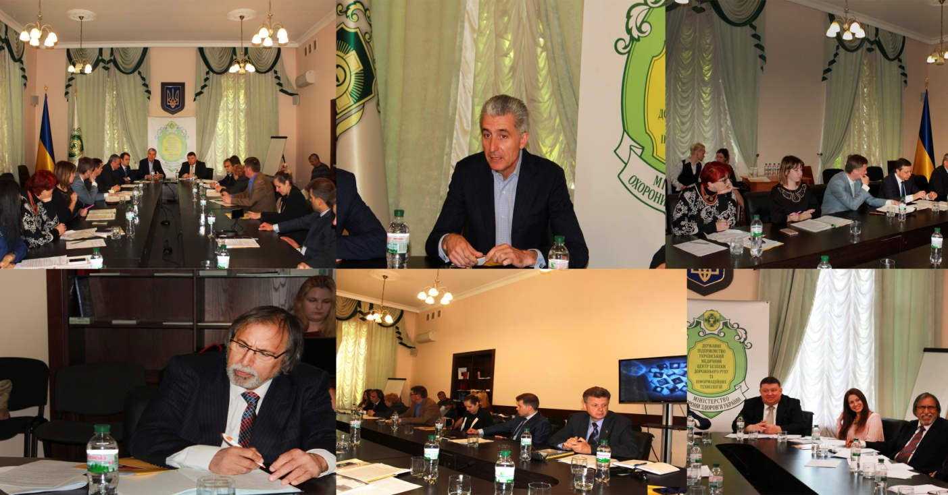
May, 18, 2016
Round-table “Perfection of relations in the field
of obligatory insurance of civil responsibility for vehicle owners
as a mechanism of social property rights protection
in road traffic accidents”
The round-table “Perfection of relations in the field of obligatory insurance of civil responsibility for vehicle owners as a mechanism of social property rights protection in road traffic accidents” was carried out under the direction of Olexander Mykhailovich Zaletov, a member of the National Commission realizing the regulation in the field of financial service market, and of Yuri Olegovych Chorny, a coordinator of the Week of the Road Traffic Safety. During this round-table different aspects were discussed concerning regulation and perfection of insurance activity in the field of guaranteeing of road traffic safety and social property rights protection following road traffic accidents.
The main theses of resolution were discussed concerning the development and perfection of obligatory insurance of civil responsibility for vehicle owners in order to improve the mechanism for compensation of loss to road traffic victims.

Slide 13
Week of Road Traffic Safety (16-22 of May 2016)
RESOLUTION
of the round-table
“Perfection of relations in the field of obligatory insurance of civil responsibility for vehicle owners as a mechanism of social property rights protection in road traffic accidents”
The insurance systems being present in modern economical structures of developed countries permit to accumulate considerable investment resources realizing simultaneously the national policy of social and economical support of population. It is known the development of insurance and of its socially important branches, first of all, aiming to protect the property interests of population, of economic activity subjects and state from negative results of unforeseen events assists the stabilization of social and economical situation and the increase of prosperity level in any country. The insurance plays, first of all, an outstanding social role for any country and its population; thus, the obligatory insurance of civil responsibility for vehicle owners belongs to necessary social instruments for financial support of the road traffic safety. Its importance is due to the necessity of complete and timely compensation for sufferers of road traffic accidents (RTAs) as well as to the support of property rights of vehicle owners and drivers. It is confirmed by a fact that such type of insurance possesses the lion’s share in the structure of risk insurance in developed countries.
According to the data of the Department of the Road Traffic Safety of the Ministry of Home Affairs of Ukraine, the total quantity of RTA cases in Ukraine in 2015 reaches 132,200; as a result, 4.5 thousand of humans have perished, 32.4 thousand of humans have been traumatized. The liquidation of the passenger transportation national monopoly weakened the control for both quality of transportation realized by workers of different companies and assurance of transportation safety. The proportion of such transporters, including physical entities, increases from year to year. As a result, the RTA level for passenger transportation has increased.
According to the data of the World Health Organization (WHO), the level of RTA-due mortality in Ukraine reaches 12 humans per 100 thousand of population being twice as high as the average level in countries of the European Union. Traffic accidents are the leading cause of mortality among young people aged from 15 to 24 and the second death cause among younger persons – children aged from 5 to 14. According to the data of the National Committee of Financial Services of Ukraine, in 2015 about 98.8 thousand of insurance cases were resolved at the obligatory insurance market, 12.3 thousand of them having been realized according a simplified system (in frames of the Europrotocol) without call of police.

Slide 14
In 2015, 1089.6 million UAH were paid to persons suffered in the RTAs, this level being by 11.4 % higher comparing to disbursements in the 2014. The imperfection of the obligatory insurance system concerning the civil responsibility generates a lot of problems preventing this system to realize its social functions. These obstacles include significant understatement of insurance policy value by unscrupulous insurance workers leading to incomplete insurance reserve formation and, as a result, to further insolvency of such insurance workers, groundless refusals to pay insurance compensations to sufferers or delayed insurance payment realization and numerous contradictions in the process of such payment sum calculation.
The acting system of obligatory insurance of civil responsibility of vehicle owners generates also serious social contradictions between RTA participants and insurance workers promoting the increase of citizens being discontented by conditions accompanying the realization of this obligatory insurance type; it leads the population to total mistrust concerning the insurance market.
The analysis of insurance services in frames of obligatory accident passenger insurance given to institutions directed by the Ministry of Infrastructure of Ukraine suggests that in the conditions of obligatory accident insurance of passengers and drivers, the funds are used ineffectively. An alternative approach of insurance on transport is the transition from personal accident insurance to obligatory insurance of the transporter responsibility. The world experience shows the insurance system of transporter responsibility brings positive results concerning both the assurance of timely compensation to sufferers and keeping of transporters’ solvency.
Taking all these data into consideration, the participants of the round-table recommend:
To the Verkhovna Rada of Ukraine:
To confirm the project of the Law of Ukraine “On the obligatory insurance of civil responsibility for owners of vehicles” N 3670 (17.10.2015) which is to help to increase the insurance support quality given to suffered persons at the expense of:
- increase of insurance sum sizes according to obligatory insurance agreements of civil responsibility of vehicle owners to levels of the European Union;
- introduction of electron form of insurance;

Slide 15
introduction of a system for direct insurance policy regulation;
perfection of insurance case regulation using a simplified approach for the RTA-concerning report;
introduction of clear regulation and time limits for decision making concerning insurance compensation evaluation and its payment;
increase of insurance worker’s responsibility for the violation of insurance compensation payment terms (regular payment) because of this worker’s fault to a person having the right to obtain such compensation;
to increase the level of the state control concerning the maintenance by insurance workers and by the Motor-Vehicle Insurance Bureau (MVIB) of Ukraine of regulations on centralized insurance reserve funds; for this aim, an authorized body should be organized having a function to confirm and to legalize these funds; in such a way this authorized body will obtain the right to control them;
determination of additional grounds for realization of regular payments by the MVID according to agreements of civil responsibility insurance;
harmonization of Ukrainian Laws positions “On the obligatory insurance of civil responsibility for owners of vehicles” and “On the restoration of the debtor’s solvency or recognition of his/her bankruptcy”, namely: to confirm the duty of property manager and liquidator of the debtor insurance worker to present to the MVID the copies of documents necessary for realization of regular payment for the insurance worker having been carried out the obligatory insurance of civil responsibility of vehicle owners;
implementation of Eurodirective requirements concerning the organization of a united informational center; every person may address to this center (it does not matter where she/he is insured) to receive consultations and information.
2. To confirm the project of the Law of Ukraine “On the introduction of changes to some Laws of Ukraine concerning the obligatory insurance of transporter’s civil responsibility on the occasion of harm having been done to lives and health of passengers and to third parts” (N 4642, 11.05.2016) in order to promote social protection of passengers and drivers, to increase of transportation service quality as well as to assure economic and passengers’ needs concerning transport services due to the transition from the personal accident insurance on transport to necessary civil responsibility insurance for transporters using vehicles, city electrical way, railway, sea transporters and transporter in inner waters for harm having been done to lives and health of passengers and to third parts.

Slide 16
To the Cabinet of Ministers:
In frames of the Decade of the Road Traffic Safety (2011-2020):
To introduce obligatory lessons concerning road traffic safety and vehicle insurance from the beginning of this new educational year in educational institutions of any property form.
To elaborate methodological approaches for evaluation of price for lives of persons having perished due to road traffic accidents.

Slide 17
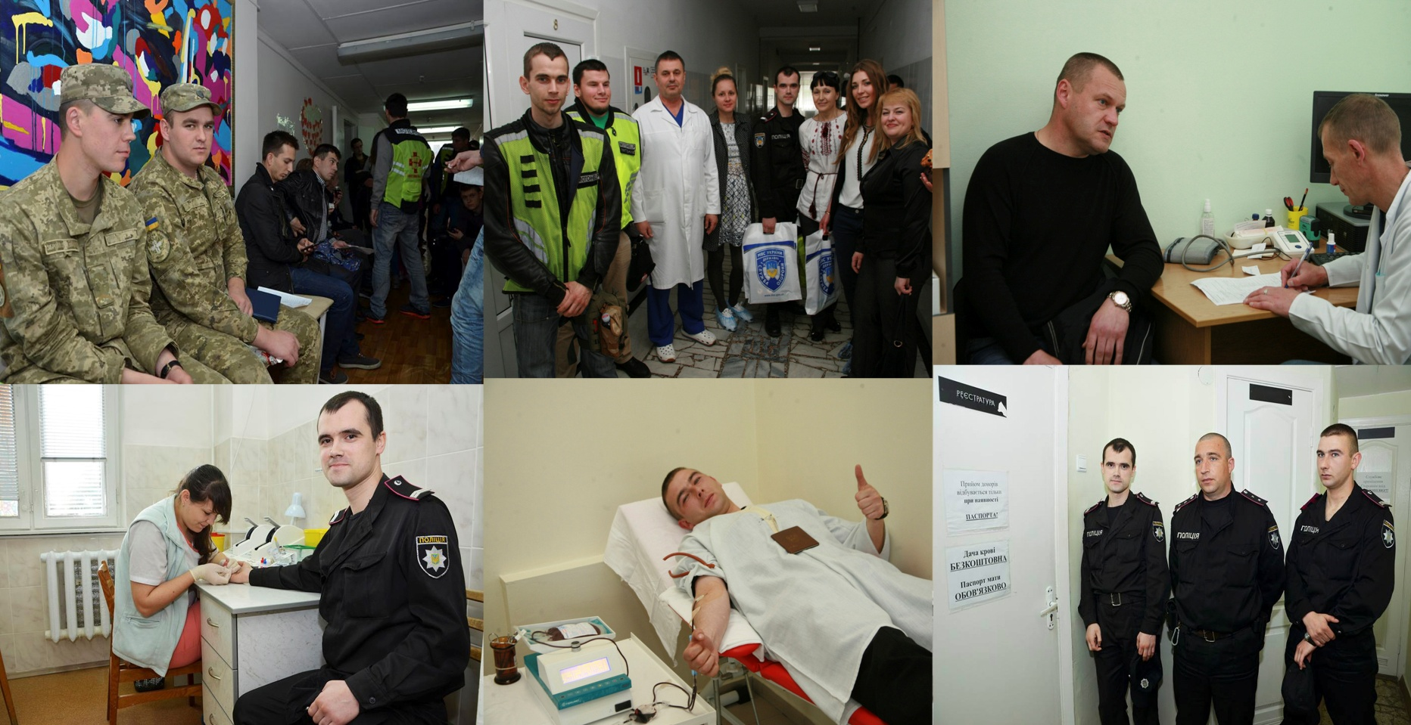
May, 19, 2016
Action “Give your blood and save a life!”
In Kyiv in the National Specialized Children Hospital “Okhmatdyt” as well as in all regions of Ukraine in frames of the Week of the Road Traffic Safety, a lot of blood donors had given their blood which was to be used for the treatment of children having been suffered due to RTAs.
In a lot of critical situations the blood is irreplaceable, the deficit of donor blood may be the cause of traumatized person death even if a patient is treated by the best physician in a modern hospital.

Slide 18
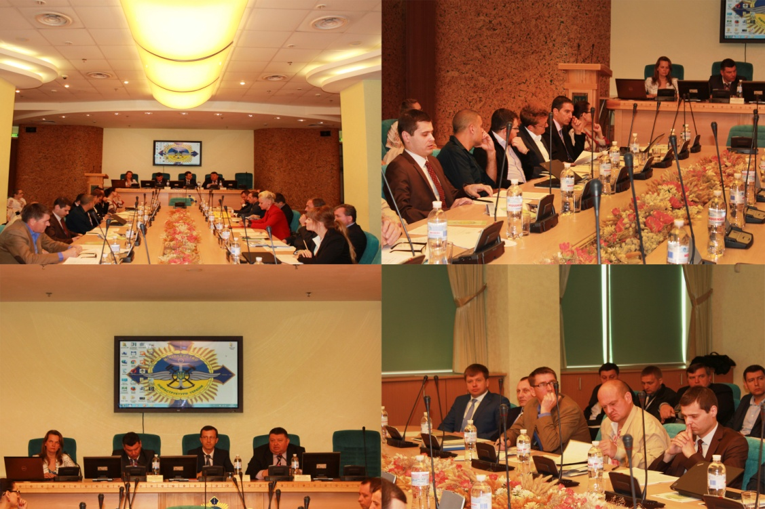
May, 19, 2016
Round-table “Road traffic safety concerning private vehicles
realizing passenger transportation”
The President of the State Service of Ukraine on the Transport Safety Mykhailo Noniak and the director of the Department of Transport Safety of the Ministry of Infrastructure of Ukraine Volodymtr Kos’kovets’ki together with a coordinator of the Week of the Road Traffic Safety in Ukraine Yuri Chorny opened the round-table and proclaimed the decrease of traumatism and fatal cases for humans to require unification of efforts of state authorities, business, public organizations, scientific community, mass-media, and of the whole society, these efforts aiming to complete state international programs concerning the road traffic safety and to propagate the importance of road traffic rules observance by all the traffic participants.

Slide 19
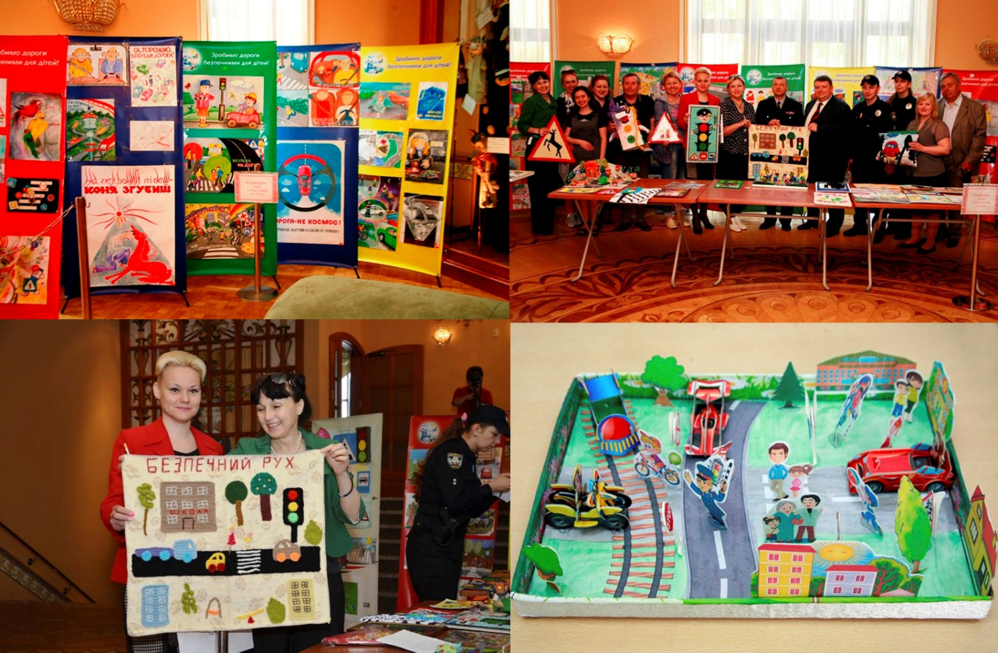
May, 20, 2016
Ceremony of winners’ rewarding
of the all-Ukrainian competition of children creative works
“Young generation supports the road traffic safety”
Besides the main competition where nine winners were found, the on-line voting in the social network “Facebook” was also carried out; according to the quantities of voices, some authors of children pictures received special prizes.
Bogdan Steshyn, a pupil of the “Berestian” studio, the author of the work “The Road is not Cosmos”, received his prize from Inna Oliferenko, the manager of the international salutary fund “Aid for Sufferers of Road Traffic Accidents”.

Slide 20
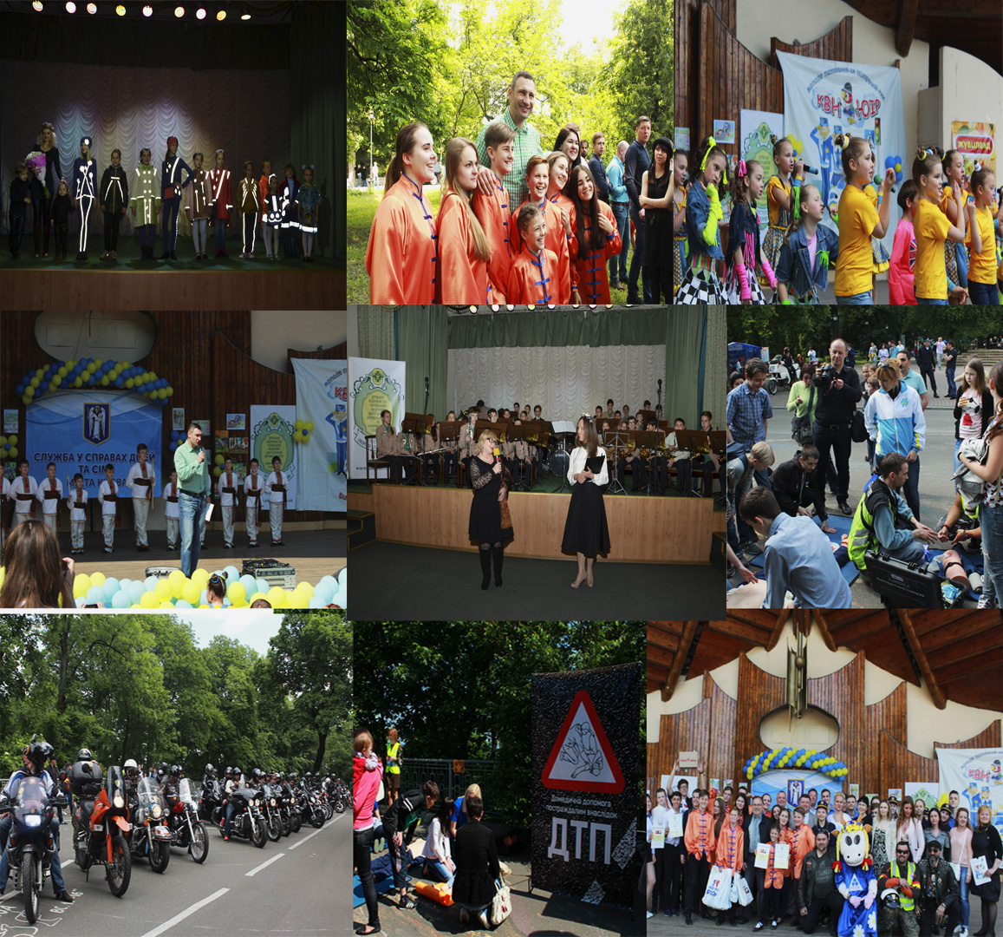
May, 22, 2016
Socio-cultural action “Family Day: Humans in Their Family Circle”
On the territory of Mariinski Park, the Central Culture and Rest Park of Kyiv, a socio-cultural action “Family Day: Humans in Their Family Circle” was organized in frames of the Week of the Road Traffic Safety. The state enterprise “Ukrainian Medical Center of Road Traffic Safety and Informational Technologies” of the Ministry of Health of Ukraine was a coordinator of this action.

Slide 21
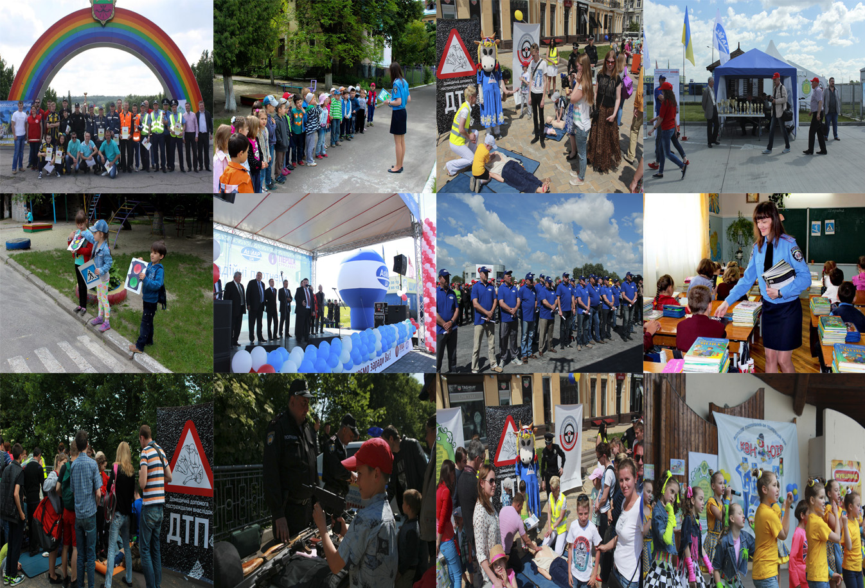
Actions in different regions of Ukraine realized in frames
of the Week of the Road Traffic Safety
From the 16th up to the 22th of May a lot of actions in frames of the week of the Road Traffic Safety were carried out in all regions of Ukraine; a lot of children and adults were participants of these actions, the road traffic safety being a part of everybody’s fate. Both citizens and state institutions joined these actions.

Slide 22
Coordinator of the Week of Road Traffic Safety
State enterprise “Ukrainian Medical Center of Road Traffic Safety and Informational Technologies” of the Ministry of Health of Ukraine
Kyiv-City, 7 Mykhailo Grushevski str.
(044) 254 05 98; 254 08 75
www.umcbdr.com.ua
www.facebook.com/tbdrua

