Slide 1



WEEK OF ROAD TRAFFIC SAFETY
THE 9-15th OF NOVEMBER 2015
Organizer: Ministry of Health of Ukraine
Coordinator: State Enterprise “Ukrainian Medical Center of Road Traffic Safety and Informational Technologies” of the Ministry of Health of Ukraine

Slide 2
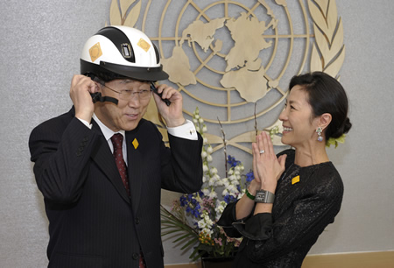

The Week passed as a part
of the Decade of Road Traffic Safety 2011-2020
Aim of the Decade: decrease of mortality and traumatism due to traffic accidents.
DIRECTION of ACTIVITIES
• Road traffic safety management
• Projecting and building of new roads
• Safe transport vehicles
• Safe behavior of road users
• Help to persons having become traffic accident victims
«The Decade of actions aiming to secure the road traffic safety may help all the countries to enter the way leading to more safe future»...
Message of the General Secretary of the UNO Pan Gi Mun on the occasion of the Decade beginning.

Slide 3
Week of the Road Traffic Safety
Weeks of the road traffic safety are now organized all over the world within the Decade of Road Traffic Safety Securing (2011-2010), their aim being the attraction of the society’s attention to problems of road accidents and mortality as well as, first of all, the search of possibilities for solving this problem. More than 1.25 million persons perish each year because of traffic accidences, about 50 million becoming traumatized.
The level of traffic traumas in Ukraine is the highest among European states as well as the level of irreparable loss of humans and economical damage.
Every year more than 4,000 persons perish on Ukrainian roads, more than 30,000 humans becoming traumatized. Traffic accidents are the leading cause of mortality among young people aged from 15 to 24 and the second death cause among younger persons – children aged from 5 to 14.
According to the Global Bank estimations, the annual economic losses of Ukraine due to traffic accidents reach $4.5 milliard – about 3.4% of the gross national product.
The World Health Organization is known to be engaged in the traffic safety problems; so the Ministry of Health of Ukraine proposed to organize every year the Week of Road Traffic Safety.
The aim of the Week of the Traffic Safety is the unification of efforts of state authorities, business, social institutions, scientific community, mass media and of whole society aiming to accomplish state and international programs concerning the traffic safety and to assure the support of rules of the road by all the traffic participants.
In 2015 the United Nations Organization determined the children safety on roads as the leading theme of the Week, so Ukraine supported this proposition and carried out the All-Ukrainian Week of the Traffic Safety having taken into consideration this theme.
During the Week the Children Declaration on the Traffic Safety (#SaveKidsLives) was signed; the results were collected on the site www.savekidslives1015.org and presented in Brasilia on the Second All-World High Level Conference on the Traffic Safety (18-19.11.2015).

Slide 4
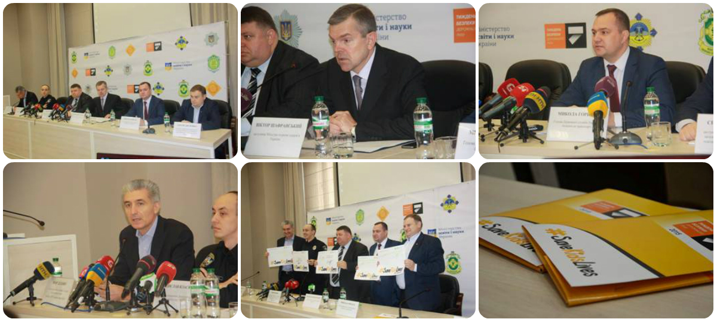
The 9th of November 2015
Press-conference on the occasion of the beginning of the Week of Road Traffic Safety
On the 9th of November a press-conference had place on the occasion of the beginning of the All-Ukrainian Week of Traffic Safety having lasted from the 9th up to the 15th November.
The Ministry of Health supported by the Ministries of Infrastructure and of Education and Science as well as by other ministries and departments, by scientific community, international and native institutions organized a series of events aiming to increase the population’s knowledge on the traffic safety, especially concerning the children’s safety, on the prevention of traumatism, health care securing of the traffic safety etc.

Slide 5
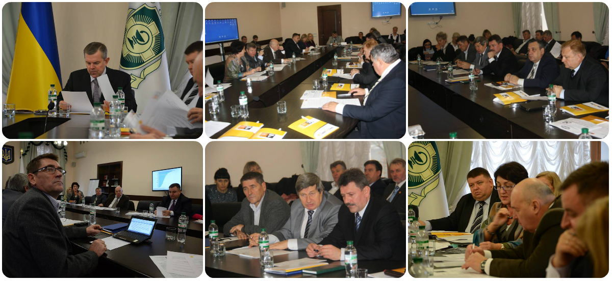
The 9th of November 2015
Round table «Health Care Securing of the Traffic Safety»
The round-table «Health Care Securing of the Traffic Safety» united the specialists from all the Ukrainian districts. The round table participants emphasized the current health care securing of the traffic safety to require juridical basis.
A working group was organized, its duties including the working out of juridical documentation.
It is necessary to elaborate the system aiming to examine drivers’ health in order to determine if the persons being examined meet the physical and mental requirements permitting them to drive vehicles.
Notes:
5

Slide 6
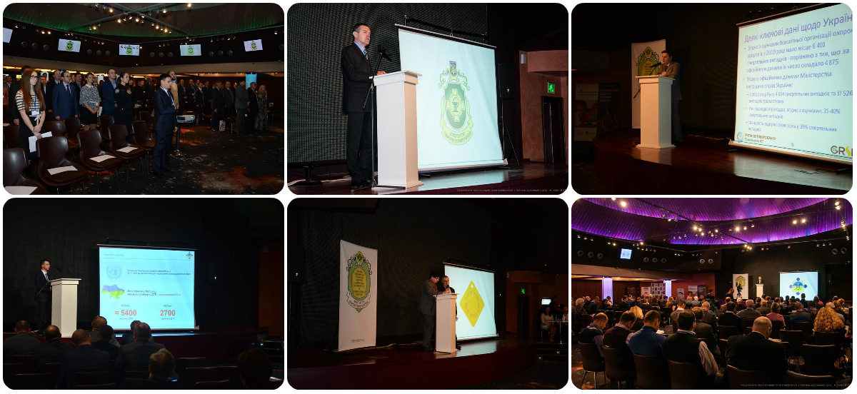
The 10th of November 2015
National Scientific-Practical Conference on the Problems of the Traffic Safety
The National Scientific-Practical Conference on the Problems of the Traffic Safety was carried out on the 10th of November; the participants were representatives of state authorities, deputies of different levels, workers of educational and scientific research field, of vehicle production plants, international institutions, social communities, trade-union associations.
The Ambassador Extraordinary and Plenipotentiary of Brasilia Fernando Cruz de Mello took also part in the Conference and emphasized the traffic safety problem to be a burning one for his country, the Week took place on the eve of the Second International High Level Conference on Traffic Safety. All the speakers underlined the necessity of complex measures intended to increase the level of traffic safety taking into consideration the experience of developed countries of Europe and the whole world.

Slide 7
The 11th of November 2015
Extended meeting of the Verkhovna Rada Committee of transport problems
«Perspective of road traffic safety up to 2020 year»
On the 10th of November the meeting of the Verkhovna Rada (Supreme Council of Ukraine) Committee of Transport Problems took place; the participants discussed the program of traffic safety up to 2020 and other questions.
The speakers underlined the mortality frequencies following traffic accidences in Ukraine to be by 2.5 times higher comparing to the European data, the quantity of vehicles and the traffic intensity in Ukraine being at the same time markedly lower.
The most important question having been discussed during this meeting is the necessity of new legislation accompanied by the current legislation improvement as well as implementation of long-termed conception of traffic safety.
The participants considered also the problem including the organization of a unified organ for coordination of all the actions of different ministries and departments concerning the traffic safety.
The meeting declared also that the project on the «State and Possibilities of Road Traffic Safety Securing» had been submitted for parliamentary discussions in Verkhovna Rada.
The main result of parliamentary discussions is expected to be the attraction of state authorities, public opinion, and mass media attention to the necessity of solving the traffic safety problems; this may lead to decreased frequencies of fatal events on roads, the quantity of perished and traumatized Ukrainian citizens becoming low. The statistical data are to become comparable with European levels and to improve the overall image of our country.
The parliamentary discussions of the problems mentioned above are the most important state instrument promoting the organization and support of discussion, all-round public examination of the traffic safety system as well as of necessary measures which are to be taken by Ukrainian state authorities in order to save citizens’ lives.
This decision was approved on the 25th of November 2015, so the realization of parliamentary discussions is to take place on the 23th of December 2015.

Slide 8
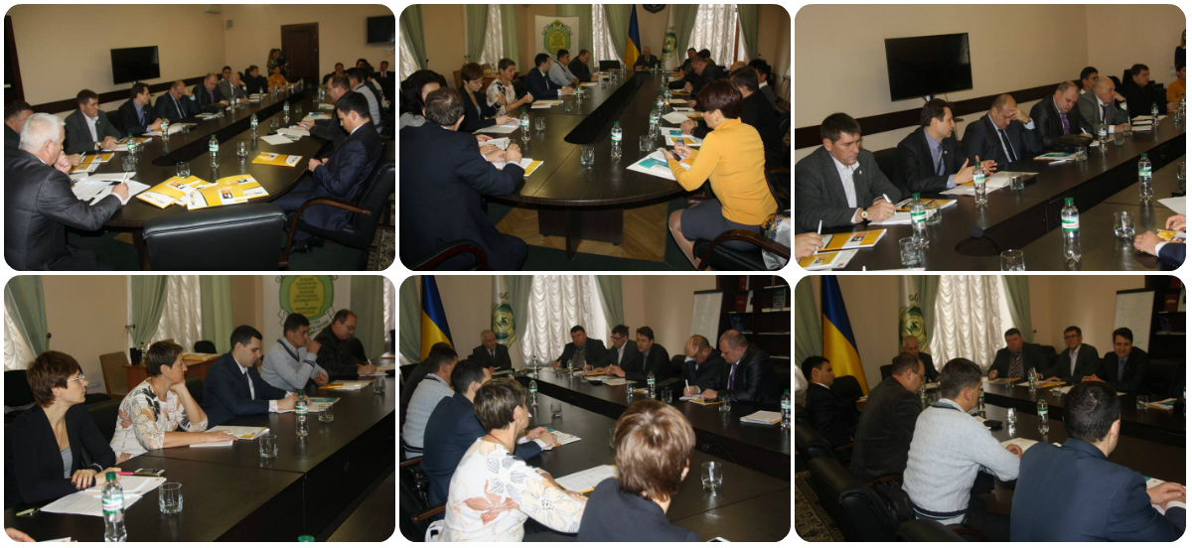
The 12th of November 2015
Round table «International Approaches to Traffic Accident Statistics»
On the 12th of November the round-table «International Approaches to Traffic Accident Statistics» was held in the Ministry of Health of Ukraine.
Currently there are marked differences between different branches making impossible the obtaining of statistically significant information.
The participants of the round table supported unanimously the proposition on the creation of the united integrated data base concerning traffic participants and traffic accidents, native and foreigner experts being coworkers in this process.

Slide 9
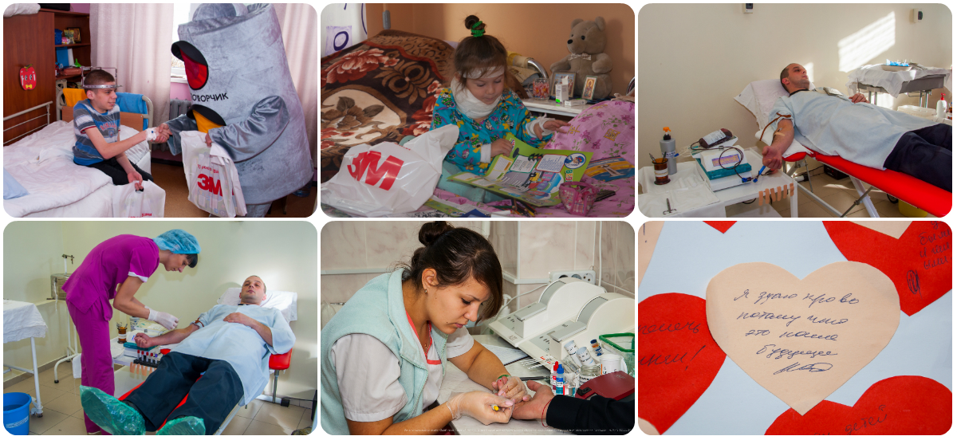
The 12th of November 2015
All-Ukrainian Action «Be a Donor – Save a Life!»
On the 12th of November an all-Ukrainian action “Be a Donor – Save a Life” was carried out. All the volunteers come to the Children Hospital “Okhmadyt” in order to become donors for children having been traumatized during traffic accidents. Among them there were also representatives of state services including policemen, guard service employees and health care workers. Besides, representatives of state services and of social community visited the Department of Children Traumatology with their presents. The children received books, bookmarks, and forms for time-tables carrying light-reflecting elements. The actions of blood donation took place in all districts of Ukraine attracting attention to children traumatism and to road traffic safety problems; the blood donations helped to manage little patients.
Mother and Child Health Protection Clinic.
Notes:
9

Slide 10
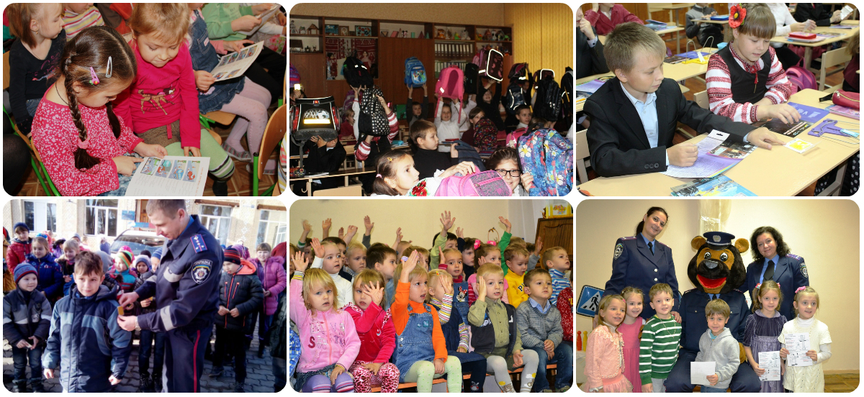
The 13th of November 2015
Lesson «Traffic Safety is the Safety for Life»
On the 13th of November and during all the Week the lessons convincing that «Traffic Safety is the Safety for Life» passed in all schools of Ukraine. During these lessons representatives of lawful institutions and social communities tried to prove to children the necessity of safe behavior on roads, to show them the profit of self-control and law-abidance. To reach this aim, to secure the real children safety, we are to direct the attention of the whole society to this especially important problem and to convince the children to understand the rules of road. The children were listening the instructions and had a possibility to watch videos concerning the correct behavior on roads and consequences of imprudence on the pavement. The children received presents – books and flickers; using these flickers the little Ukrainian citizens will be well visible on roads in the darkness.
Notes:
10

Slide 11
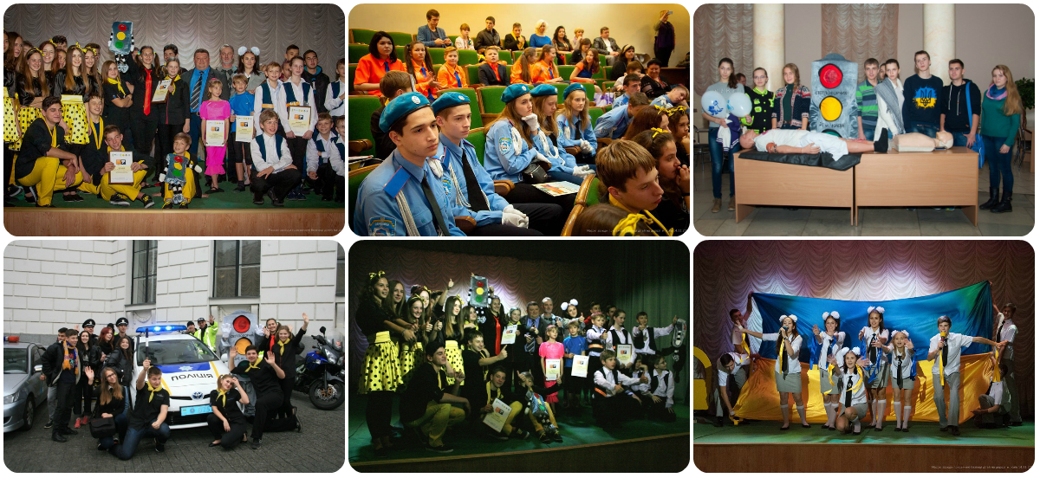
The 14th of November 2015
Public events concerning the children safety on roads
Public events concerning the children safety on roads took place on the 14th of November in Kyiv and other cities of Ukraine.
The programs included a lot of very interesting events – master-classes and first aid teaching, expositions of children works on the traffic safety theme, shows prepared by young inspectors of the traffic safety as well as by children teams “of gay and quick-witted persons”, final stage of the all-Ukrainian competition of designers having elaborated children’s clothes with light-reflecting elements (“A visible child is an alive child”); the children sang songs, played in orchestra, showed amusing tricks; at last the Children Declaration of the Road Traffic Safety was signed.
Notes:
11

Slide 12
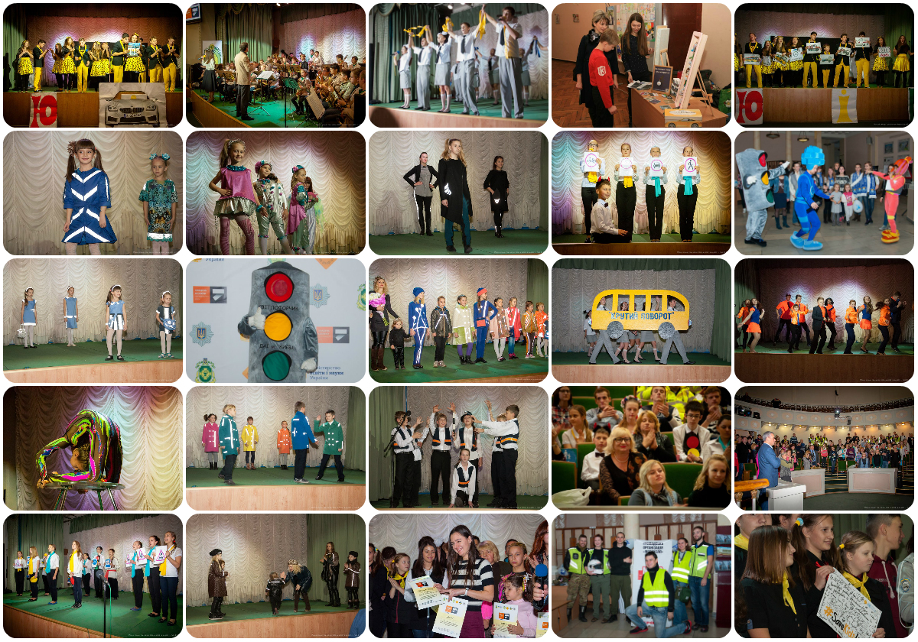
The 14th of November 2015
Public events concerning the children safety on roads
Notes:
12

Slide 13
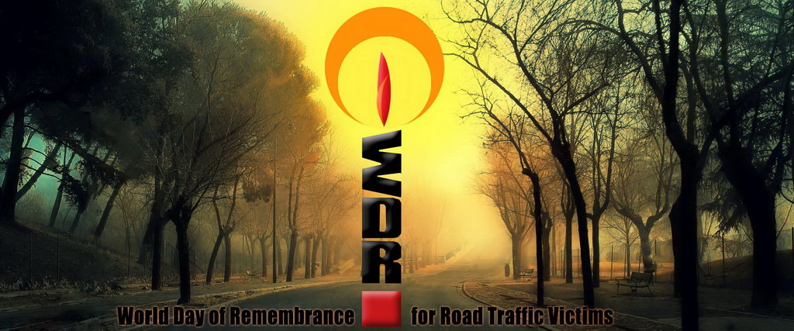
The 15th of November 2015
Word Day of Remembrance for Road Traffic Victims
According to the UNO resolution, in Ukraine, as well as in the whole world, different events concerning the World Day of Remembrance for Road Traffic Victims are annually realized on the third Sunday of November.
On the 15th of November 2015 memorial services took place in all the temples of Ukraine in order to make mention of people who had perished because of traffic accidents.
The representatives of clergy underline the Church cannot stand aloof when the situation with traffic accidents in our country is so dramatic. The Church cannot forget to carry out memorial services and to mention the people who had perished; at the same time the Church prays those who are alive to be responsible and prudent during driving.

Slide 14
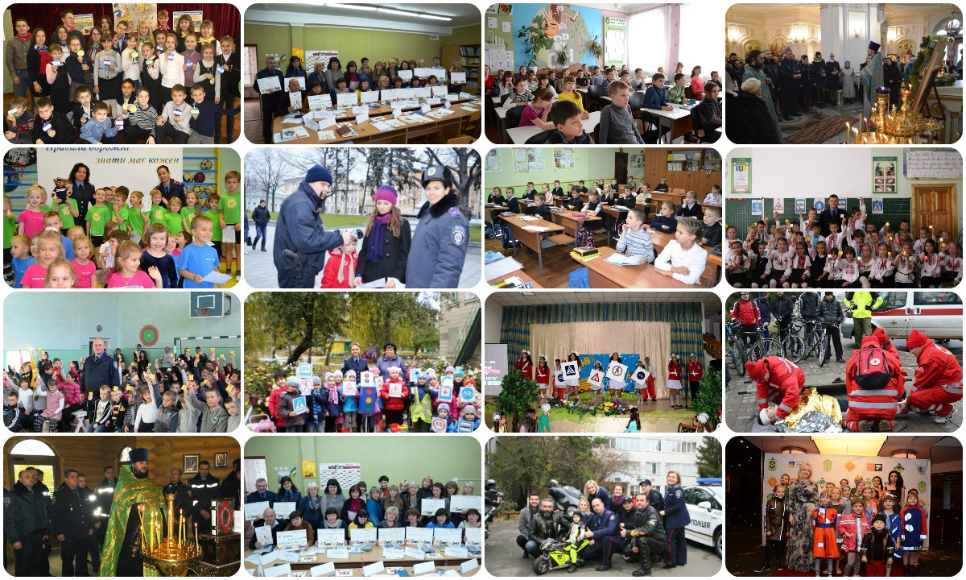
Events in different districts of Ukraine
From the 9th up to the 15th November the Week of the Road Traffic Safety was noted in all districts of Ukraine; a lot of children and adults took part in these events, as the traffic safety concerns each person. All citizens who wish as well as many state authorities were participants of these events.
Notes:
14

Slide 15
Coordinator of the Week of Road Traffic Safety
State Enterprise “Ukrainian Medical Center of Road Traffic Safety and Informational Technologies” of the Ministry of Health of Ukraine
7 Mykhailo Grushevski str., Kiev, Ukraine
(044) 254 05 98
www.umcbdr.com.ua
www.facebook.com/tbdrua

